Slide 1

Arrays(1D and 2D)

Slide 2
Outline
To declare an array
To initialize an array
Operations on array

Slide 3


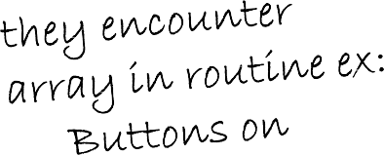



Introduction
Arrays
Collection of related data it
type.
Static entity – i.e. they rem throughout program execu
ems of same data
ain the same size tion

Slide 4
Arrays
Name that this same
of array (Note all elements of
Array
array have the name, c)
– Group of consecutive memory locations_{c[0]}
-45
6
0
72
3
-89
0
62
-3
1
6453
78
– Same name and data type
To refer to an element, specify:
c[1]
c[2]
c[3]
c[4]
– Array name
– Position number in square brackets([]) ^{c[5]}
c[6]
c[7]
c[8]
c[9]
c[10]
c[11]
Format:
arrayname[position_number]
First element is always at position 0
Eg. n element array named c:
c[0], c[1]...c[n – 1]
Position number of the element within array c
@LPU CSE202 C++ Programming

Slide 5
Arrays
An array is an ordered list of values
The entire array Each value has a numeric index
has a single name
c[0] c[1] c[2] c[3] c[4] c[5] c[6] c[7] c[8]
c[9]
79 | 87 | 94 | 82 | 67 | 98 | 87 | 81 | 74 | 91
c
An array of size N is indexed from zero to N-1
This array holds 10 values that are indexed from 0 to 9

Slide 6
Arrays
Array elements are like normal variables
c[0] = 3;/*stores 3 to c[0] element*/
The position number inside square brackets is called
subscript/index.
Subscript must be integer or an integer expression
c[5 - 2] = 7; (i.e. c[3] = 7)

Slide 7
Defining Arrays
When defining arrays, specify:
Name
Data Type of array
Number of elements
datatype arrayName[numberOfElements];
Examples:
int students[10]; float myArray[3284];
Defining multiple arrays of same data type
Format is similar to regular variables
Example:
int b[100], x[27];

Slide 8
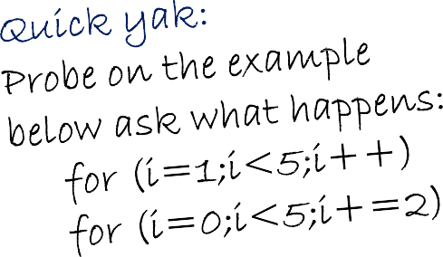
Initializing Arrays
Initializers
int n[5] = { 1, 2, 3,
If not enough initializers elements become 0
– int n[5] = { 0 }; //
C arrays have no bound
If size is omitted, initializers determine it
int n[] = { 1, 2, 3, 4, 5 };
5 initializers, therefore 5 element array.
4, 5 };
given, then rightmost
initialize all elements to s checking.
0

Slide 9
Initializing Arrays
Array is same as the variable can prompt for value from the user at run time.
Array is a group of elements so we use for loop to get the values of every element instead of getting single value at a time.
Example: int array[5]; // array of size 5
for(int i=0;i<5;i++){// loop begins from 0 to 4
cin>>array[i];
}

Slide 10
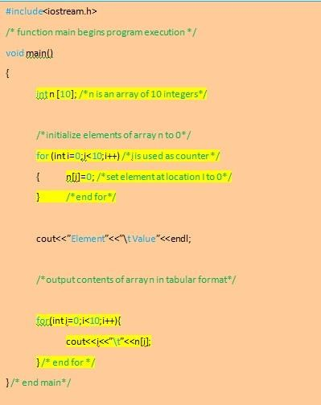
Program of Initializing an array to zero using loop.

Slide 11

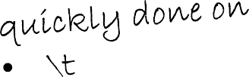


Element | Value
0 | 0
1 | 0
2 | 0
3 | 0
4 | 0
5 | 0
6 | 0
7 | 0
8 | 0
9 | 0
n[0]
n[1]
n[2]
n[3]
n[4]
n[5]
n[6]
n[7]
n[8]
n[9]
0
0
0
0
0
0
0
0
0

Slide 12
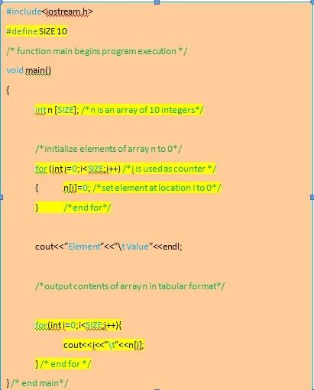
Program of Initializing an array element with calculations using loop.

Slide 13
Element | Value
0 | 2
1 | 4
2 | 6
3 | 8
4 | 10
5 | 12
6 | 14
7 | 16
8 | 18
9 | 20
n[0]
n[1]
n[2]
n[3]
n[4]
n[5]
n[6]
n[7]
n[8]
n[9]
4
6
8
10
12
14
16
18
20

Slide 14
Operations on arrays
Insertion of element into an array
Deletion of element from an array
Search of element in an array

Slide 15
#include<iostream> using namespace std; int main()
{
int a[100],i,n,k, item;
cout<<"how many no to store in array";
cin>>n;
cout<<"Enter the number"; for(i=0;i<=n-1;i++)
cin>>a[i];
cout<<"Enter the no. and its position"; cin>>tem>>k;
k=k-1;
for(i=n-1;i>=k;i--)
{
a[i+1]=a[i];
}
a[k]=item;
cout<<"Contents of the array\n"; for(i=0;i<=n;i++)
{
cout<<a[i];
}
return 0;
}
Program to insert an element into an array

Slide 16
How many no to store in array: 4
Enter the number: 12 14
5
11
Enter the no. and the position: 20 Content of the array
12
14
5
20
11
Output
3

Slide 17
#include<iostream> using namespace std; int main()
{
int a[100],i,n,k;
cout<<"how many no to store in array"<<endl;
cin>>n;
cout<<"enter the number"<<endl; for(i=0;i<n;i++)
cin>>a[i];
cout<<"enter the position"; cin>>k;
k=k-1; for(i=k;i<n;i++)
{
a[i]=a[i+1];
}
cout<<"contents of the array"<<endl; for(i=0;i<n-1;i++)
{
cout<<a[i];
}
getch();
}
Program to delete an element from an array

Slide 18
Output
How many no to store in array: 4 Enter the number: 12
14
5
11
Enter the position: 3 Content of the array
12
14
11

Slide 19
Searching in Arrays
The process of finding a particular element of an array is called searching.
Search an array for a key value.
Two searching techniques:
Linear search
Binary search

Slide 20
Linear search
Linear search
Simple
Compare each element of array with key value
Useful for small and unsorted arrays
It simply examines each element sequentially, starting with the first element, until it finds the key element or it reaches the end of the array.
Example: If you were looking for someone on a moving passenger train, you would use a sequential search.

Slide 21
#include<iostream> using namespace std; int main()
{
int a[20],key,i,n, c=-1;
cout<<“Enter the number of elements:\t"; cin>>n;
cout<<"Enter the elements:\t";
for(i=0;i<n;i++) cin>>a[i];
cout<<"Enter the element to be found \t"; cin>>key;
for(i=0;i<n;i++)
if(a[i]==key) //comparison
{
cout<<“Key found at location \t"<<i; c++;
break;
}
if (c==-1)
cout<<"element not found in the list";
return 0;
}
Program of linear search in an array.

Slide 22
Output
Enter the number of elements: 4
Enter the element: 12 14
5
11
Enter a number to be found: 14 Key found at location 2

Slide 23
Binary search
Binary search
Applicable for sorted arrays
The algorithm locates the middle element of the array and compares it to the key value.
Compares middle element with the key
If equal, match found
If key < middle, looks in left half of middle
If key > middle, looks in right half of middle
Repeat (the algorithm is repeated on one-quarter of the original array.)

Slide 24
Binary search
It repeatedly divides the sequence in two, each time restricting the search to the half that would contain the element.
This is a tremendous increase in performance over the linear search that required comparing the search key to an average of half of the array elements.
You might use the binary search to look up a word in a dictionary

Slide 25
#include<iostream> using namespace std; int main()
{
int ar[100],beg,mid,end,i,n,search; cout<<"How many numbers in the array: "; cin>>n;
cout<<"Enter "<<n<<" numbers in ascending order --> "; for(i=0;i<n;i++)
cin>>ar[i]; beg=0;end=n-1;
cout<<"Enter a number to search: "; cin>>search;
while(beg<=end)
{
mid=(beg+end)/2;
if(ar[mid]==search)
cout<<"\nItem found at position"<<(mid+1); if(search>ar[mid])
beg=mid+1;
else
end=mid-1;
Program of
binary search in an array.
}
cout<<"\nSorry! "<<search<<" doesnot found.";
return 0;
}

Slide 26
Output
How many numbers in the array: 4
Enter 4 numbers in ascending order→12 14
26
47
Enter a number to search:26 Item found at position 3

